Slide 1
Real-time integrated Healthcare Management Platform
Transforming Healthcare Through Technology
Presented by: Seif Mansour (23012749)

Slide 2
The Problem
Medication non-adherence affects over 50% of chronic patients, leading to poor health outcomes and increased costs.
Fragmented systems and lack of real-time communication hinder efficient healthcare delivery.
Patients face challenges managing medications, appointments, and health records.

Slide 3

Key Features
Medication Tracking: Schedule reminders and monitor progress.
Appointment Scheduling: Book, modify, or cancel seamlessly.
Real-time Chat: Communicate directly with healthcare providers.
Data Sharing: Securely share health records.
Reports saving: Having all previous reports and analytics

Slide 4
Tools and Technologies
Front-end: React.js
Back-end: Django (Python-based)
Database: MongoDB
Design Tools: Figma for UI/UX
Testing: Postman

Slide 5
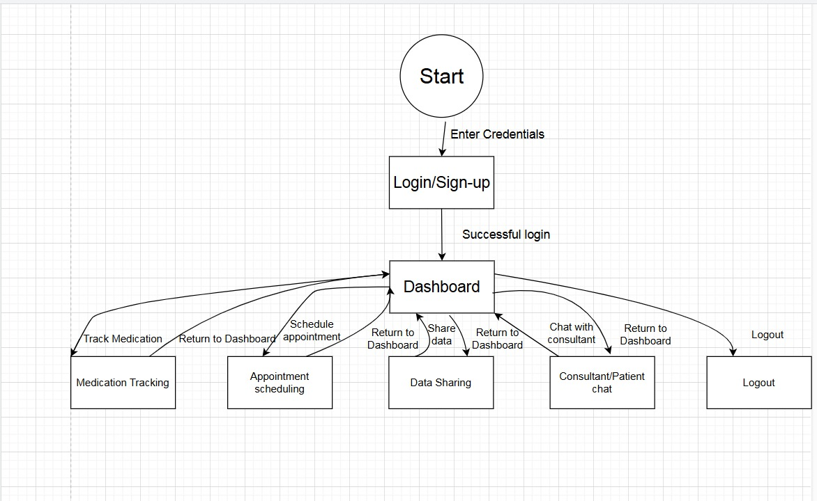
Workflow Overview

Slide 6
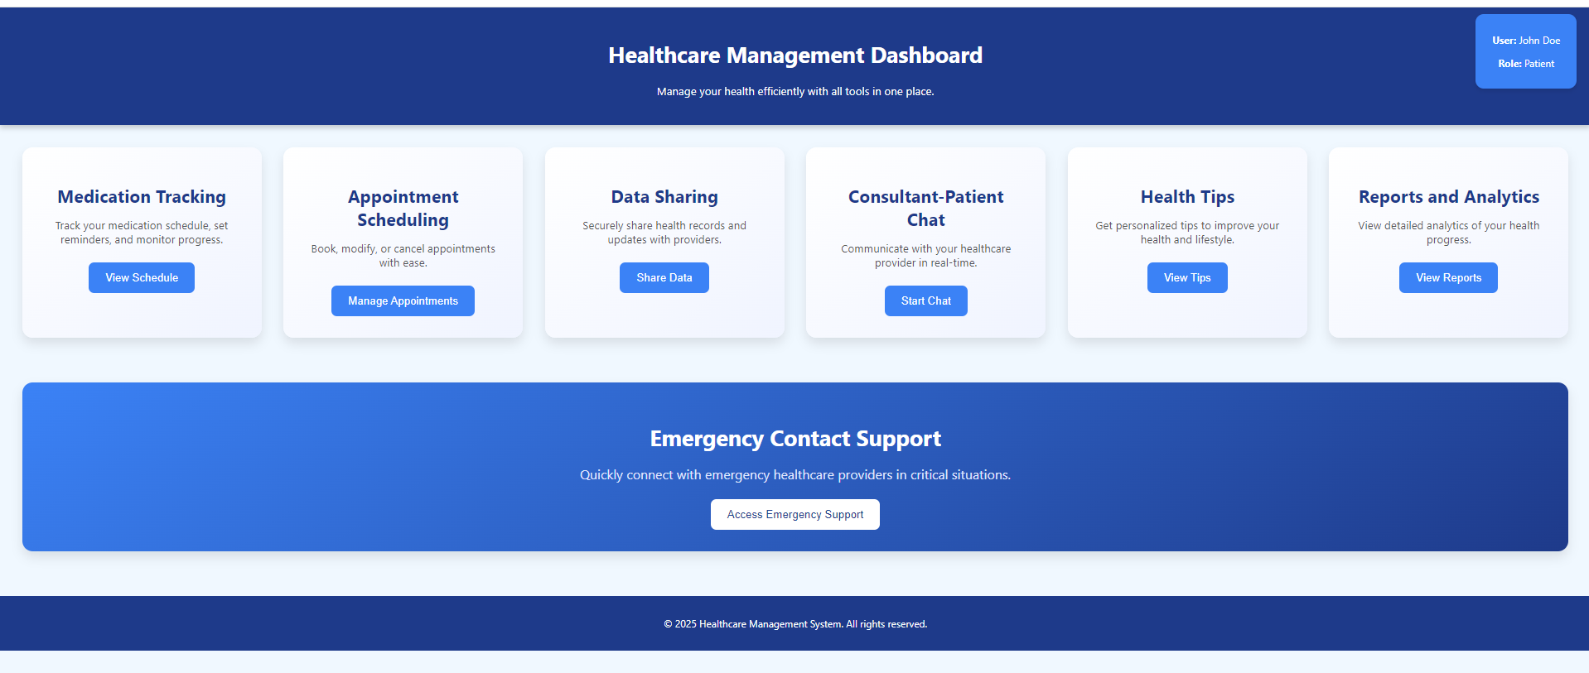
Initial dashboard sample

Slide 7
Extra features ideas
AI-powered chatbot for answering health-related queries and medication guidance.
Video consultations with healthcare providers for remote access.
Rewards and badges for consistent medication adherence and completing health goals.
Virtual Assistant
Telemedicine Integration
Gamification

Slide 8
Conclusion
The platform simplifies healthcare for patients and providers.
It ensures better health outcomes and easier communication.
Extra features could help patients .

